Slide 1
Murach’s ASP.NET Core MVC (2nd Ed.)
Chapter 5
How to manually test and debug an ASP.NET Core web app

Slide 2
Objectives (part 1)
Applied
Manually test a web app in multiple browsers to find errors.
Use the debugging techniques presented in this chapter to determine the cause of errors so you can fix them.
Knowledge
Describe how to use Visual Studio to change the default browser.
Explain how the Hot Reload feature of Visual Studio works.
Describe some of the debugging features provided by the developer tools of the major browsers.
Describe the conditions under which the Internal Server Error page is displayed.
Describe the conditions under which the Exception Helper dialog is displayed.

Slide 3
Objectives (part 2)
Distinguish between a breakpoint and a tracepoint.
Describe the three Step commands that you can use to control the execution of an app when it reaches a breakpoint: Step Into, Step Over, and Step Out.
Describe the use of the Locals and Watch windows.
Describe the use of the Immediate window.
Describe how to use tracepoints to log messages to the Output window.

Slide 4
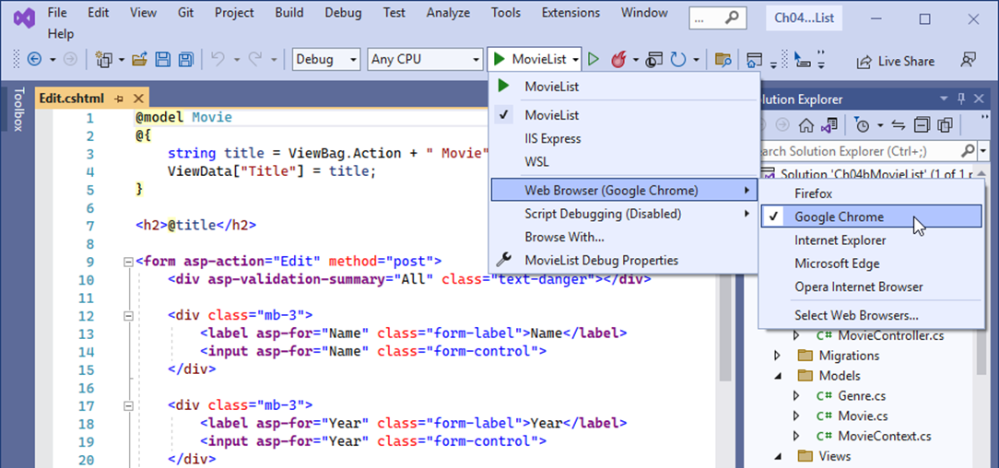
The Start drop-down menu and the Web Browser menu
How to change the default browser
Display the Start drop-down menu by clicking on its down arrow. Then, display the Web Browser menu and select a browser from it.

Slide 5
How to run an app without debugging
Press Ctrl+F5.
Click the Start Without Debugging button in the Standard toolbar.
Select Debug→Start Without Debugging.
How to run an app with debugging
Press F5.
Click the Start button in the Standard toolbar.
Select Debug→Start Debugging.
How to stop debugging
Press Shift+F5.
Click the Stop Debugging button in the Debug toolbar.
Select Debug→Stop Debugging.

Slide 6
How to run an app in multiple browsers
To run an app in two or more browsers, select Browse With from the Start drop-down menu. Then, in the resulting dialog, hold down the Ctrl key, select the browsers you want to use, and click the Browse button.
When you run an app in two or more browsers, the app is run without debugging.

Slide 7
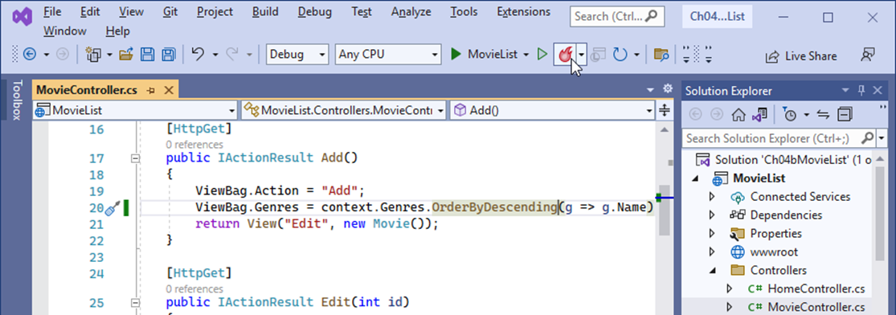
The Hot Reload button in Visual Studio
How to use Hot Reload
While an app is running, make the changes you want to apply.
Save your changes and then click the Hot Reload button to apply them.

Slide 8
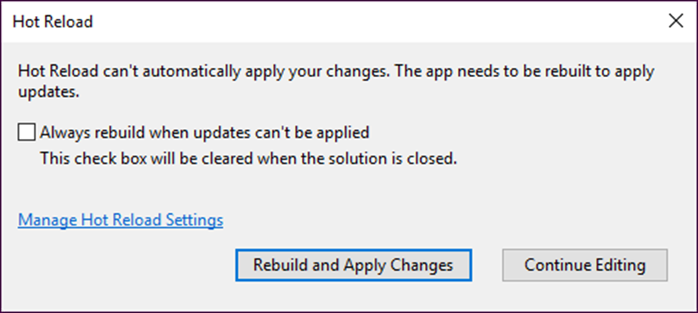
Types of changes you can apply with Hot Reload
Changes to most C# code in controllers, models, and Razor views
Changes to CSS code
The dialog for changes that can’t be made

Slide 9
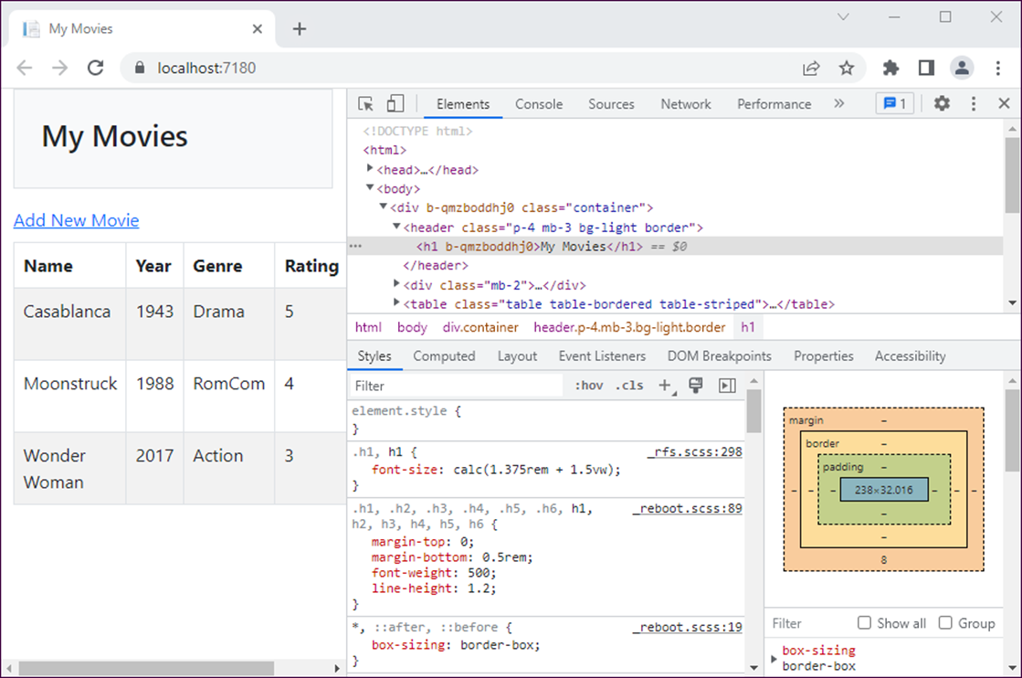
Chrome with the Elements tab of the Developer Tools open

Slide 10
How to open and close the Developer Tools
In Chrome and Edge
To open, press F12. Or, right-click an element in the page and select Inspect.
To close, press F12. Or, click the X in the upper right corner of the tools panel.
In Safari
To open, right-click an element in the page and select Inspect Element.
To close, click the X in the upper right corner of the tools panel.
You must enable the developer tools before you can use them. To do that, select Preferences, click the Advanced tab, and select the “Show Develop menu” item.

Slide 11
How to view the rendered HTML and CSS styles
Open the Elements panel by clicking on its tab.
Expand the nodes to navigate to the element you want. Then, click that element.
The HTML elements for a page are typically shown in the top of the panel, and the CSS styles for the selected element are typically shown below the HTML elements.

Slide 12
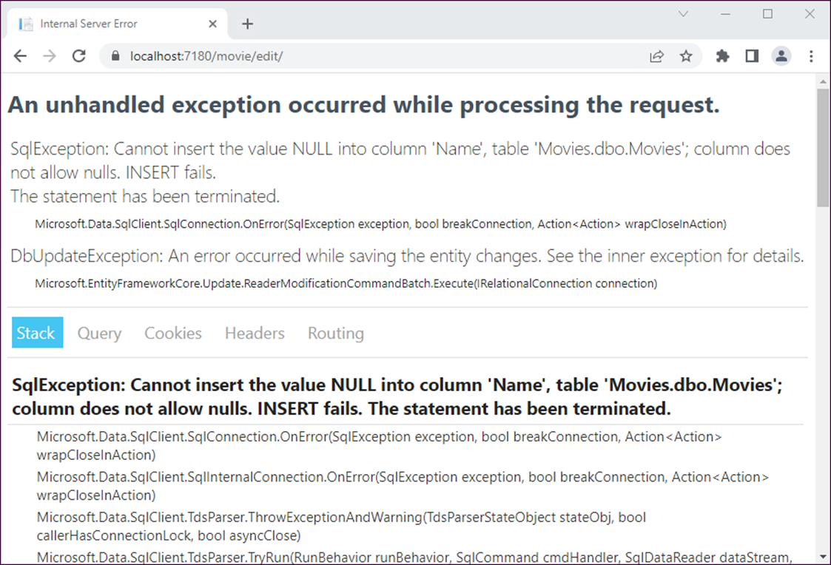
The Internal Server Error page

Slide 13
The Internal Server Error page can display…
The name and description of the exception.
A stack trace that you can use to find the line of code that caused the exception.
Query strings, cookies, headers, and routing data for the current request.

Slide 14
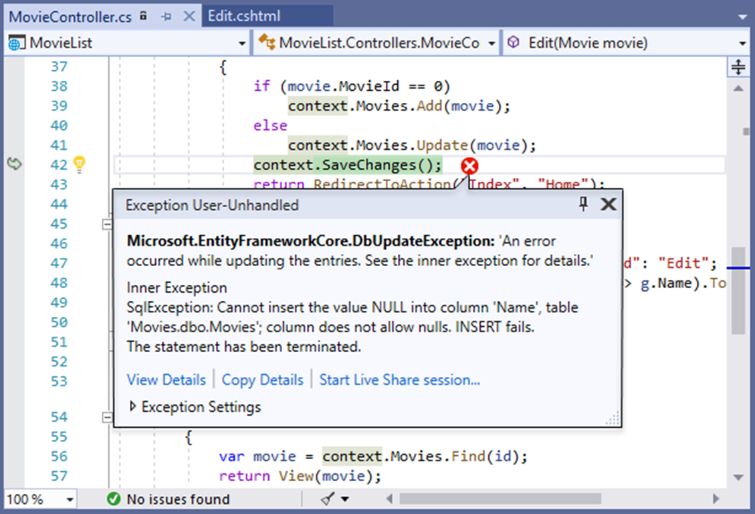
The Exception Helper

Slide 15
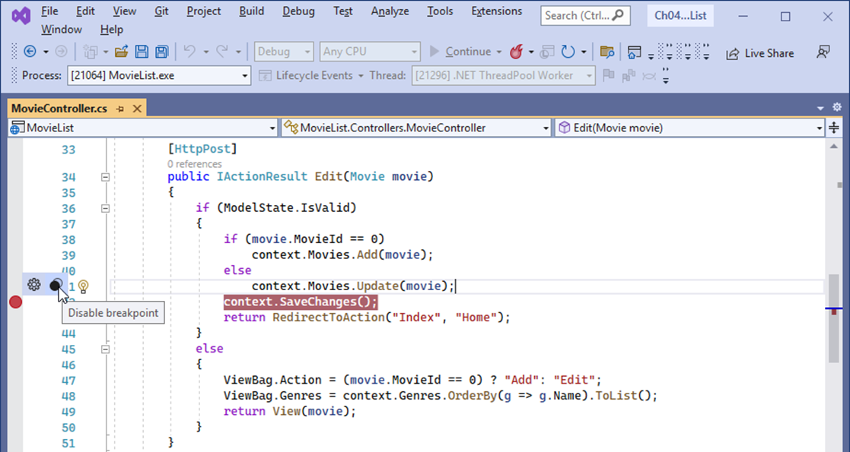
The Movie controller with a breakpoint

Slide 16
How to set and remove breakpoints
To set a breakpoint, click in the margin indicator bar to the left of the line number for a statement. This highlights the statement and adds a breakpoint indicator (a red dot) in the margin.
To remove a breakpoint, click the breakpoint indicator.
To remove all breakpoints, select Debug→Delete All Breakpoints.

Slide 17
How to enable and disable breakpoints
To enable or disable a breakpoint, point to the breakpoint indicator and select Enable/Disable Breakpoint from the resulting menu.
To disable all breakpoints, select Debug→Disable All Breakpoints.
To enable all breakpoints, select Debug→Enable All Breakpoints.
To display the Breakpoints window, select Debug→Windows→Breakpoints. This window is most useful for enabling and disabling existing breakpoints.

Slide 18
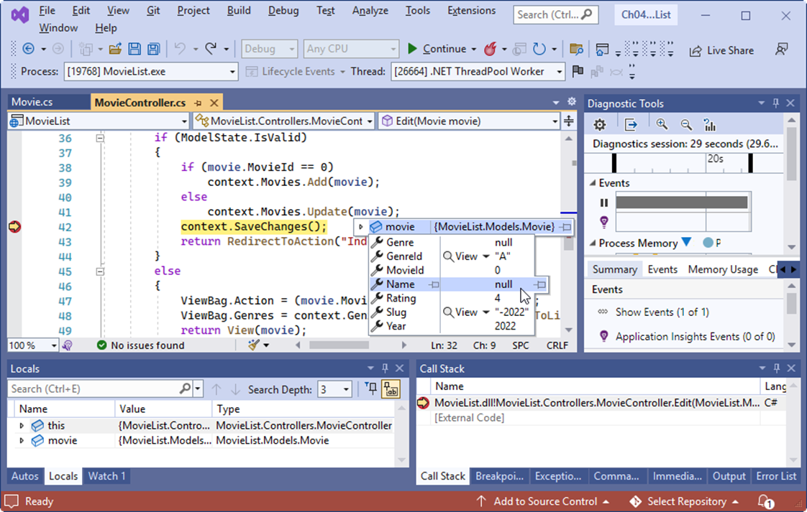
The Movie List app in break mode

Slide 19
Commands in the Debug menu and toolbar
Command | Keyboard
Start/Continue | F5
Break All | Ctrl+Alt+Break
Stop Debugging | Shift+F5
Restart | Ctrl+Shift+F5
Step Into | F11
Step Over | F10
Step Out | Shift+F11

Slide 20
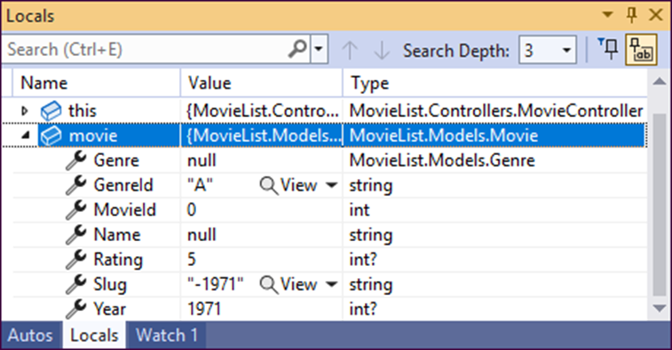
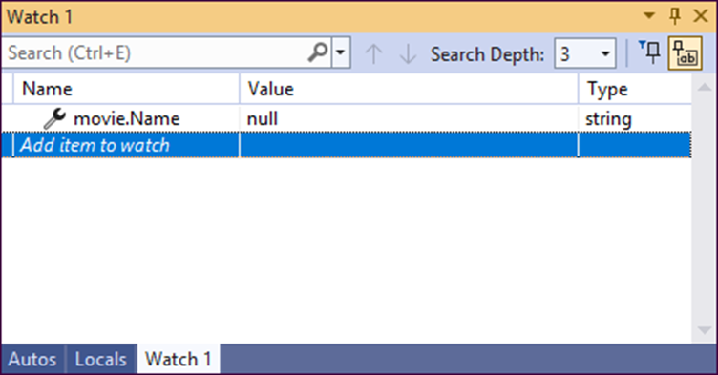
The Locals and Watch windows

Slide 21
How to use the Locals, Autos, and Watch windows
The Locals window displays information about the variables within the scope of the current method.
The Autos window works like the Locals window, but it only displays information about variables used by the current statement and the previous statement.
The Watch windows let you view the values of variables and expressions that you specify, called watch expressions. To add a watch expression, type a variable name or expression into the Name column. To delete a row from a Watch window, right-click the row and select Delete Watch.

Slide 22
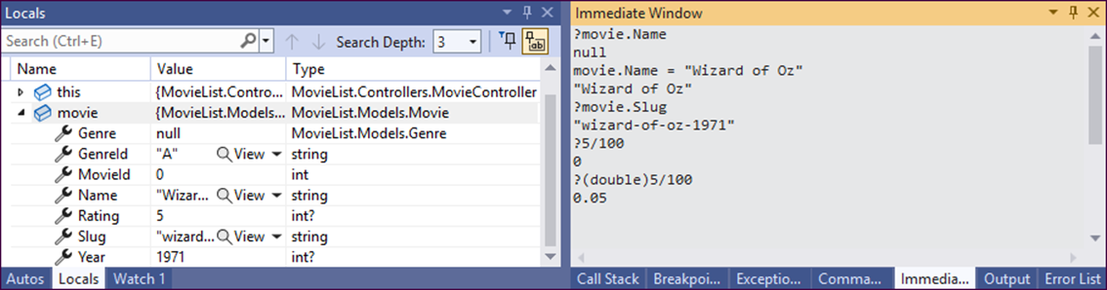
The Immediate window

Slide 23
How to use the Immediate window
To display the current value of a variable or expression, type a question mark followed by a variable name or expression. Then, press Enter.
To execute a statement, type the statement. Then, press Enter.
To execute an existing command, press the Up or Down arrow until you have displayed the command. Then, press Enter.
To remove all commands and output, right-click the window and select Clear All.

Slide 24
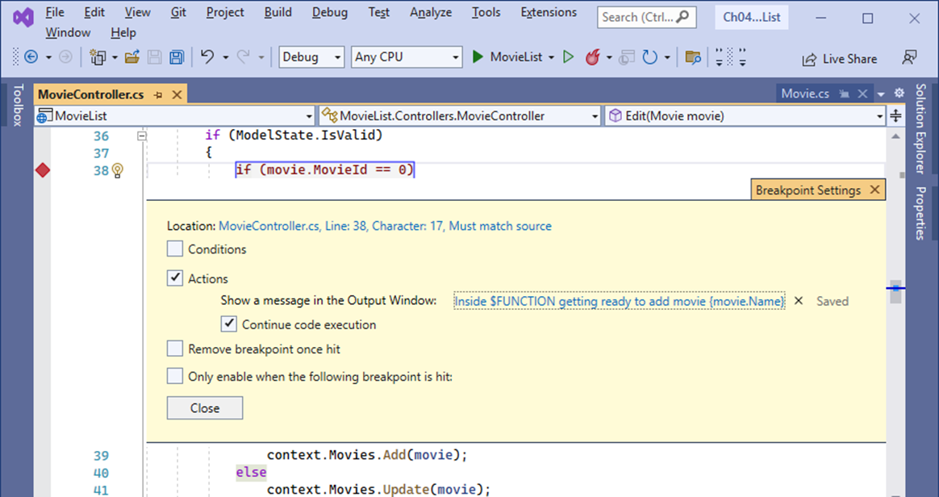
The Movie controller with a tracepoint that logs a message

Slide 25
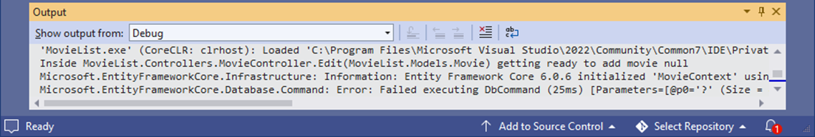
The Output window that displays the message

Slide 26
How to set a tracepoint
To set a new tracepoint, right-click a statement and select Breakpoint→Insert Tracepoint. Then, complete the Breakpoint Settings window.
To convert an existing breakpoint to a tracepoint, point to the breakpoint icon, click the Settings icon that looks like a gear, and complete the Breakpoint Settings window.
For a tracepoint, the Breakpoint Settings window should have the Continue Code Execution option selected. That way, it doesn’t enter break mode like a breakpoint.
When logging a message to the Output window, you can include the value of a variable or other expression by placing the variable or expression inside braces, and you can include special keywords such as FUNCTION by coding a dollar sign ($) followed by the keyword.

